Slide 1

“LEAD Netroots Movement”
Dr. Enrique Murillo, Jr.
Executive Director, LATINO EDUCATION AND ADVOCACY DAYS ORGANIZATION
Faculty Director, EdD Doctoral Program in Educational Leadership
Professor, College of Education, California State University, San Bernardino

Slide 2

Chicano/Latino education equity and advocacy
Goals of the Workshop
• Raise awareness
• Share strategies
• Empower advocates
• Showcase LEAD

Slide 3
Chicano/Latino education equity and advocacy focuses on addressing systemic barriers and promoting equitable educational opportunities for Latino students.
This involves advocating for policies and practices that ensure access to high-quality education, culturally relevant curriculum, and support services from early childhood through higher education.
Organizations and advocates work to dismantle discriminatory practices, increase Latino representation in the education workforce, and empower Latino communities to participate fully in the educational process.

Slide 4
SOME KEY STARTING POINTS OF GENERAL AWARENESS:
1. In January 2003, Latinos were recognized, numerically, as the largest minority group in the U.S.
2. As of 1998, Latino children, numerically, had already become the largest minority student demographic in U.S. public schools

Slide 5
SOME KEY STARTING POINTS OF GENERAL AWARENESS:
3. Latino students, in general are the most under-educated major segment of the U.S. population, and are more than twice as likely to be undereducated than all groups combined

Slide 6
SOME KEY STARTING POINTS OF GENERAL AWARENESS:
4. Latino students in particular, have the highest dropout (“pushout”) rate, score among the lowest on achievement tests, and have low college enrollment rates

Slide 7
We can’t say with absolute certainty what are the full causes of the Latino Achievement Gap!
But we know some likely contributors, from the research literature

Slide 8
LATINO STUDENTS ATTEND SCHOOLS:
with fewer resources, staffing and programs
with a high mobility rate of both students and teachers
that are located in communities with high poverty rates
that are racially segregated (with academically segregated tracks)
with less-qualified teachers
with more and harsher discipline
with lowered expectations for student achievement, and
with mismatches between school and home culture

Slide 9
These historical efforts have had a lasting impact on education, leading to greater access, equity, and representation for Chicano/Latino students and communities.
Historical Context
Challenging Educational Segregation:
Legal Challenges: Throughout the 1930s and beyond, Mexican Americans filed numerous legal cases challenging segregation and unequal treatment in education.
Lemon Grove Incident: In 1930, Mexican American families in Lemon Grove, CA, resisted the construction of a separate school for their children, ultimately winning their case against the school board.
Mendez v. Westminster: In 1947, this landmark case in California successfully challenged the segregation of Mexican and Mexican-American students in schools, setting a precedent for the later Brown v. Board of Education decision.

Slide 10
These historical efforts have had a lasting impact on education, leading to greater access, equity, and representation for Chicano/Latino students and communities.
Historical Context
Advocacy for Bilingual Education and Cultural Representation:
Bilingual Education Act: The advocacy efforts of Latino activists led to the passage of the Bilingual Education Act, which mandated bilingual instruction in schools with significant non-English speaking populations.
Ethnic Studies Programs:
The establishment of Ethnic Studies programs, like the one at San Francisco State University, was a direct result of Chicano/Latino advocacy for culturally relevant curriculum and representation in education.
Curriculum Reform: Chicano/Latino activists fought for the inclusion of their history, culture, and experiences in school curricula, challenging the Eurocentric perspectives that often dominated educational materials.

Slide 11
These historical efforts have had a lasting impact on education, leading to greater access, equity, and representation for Chicano/Latino students and communities.
Historical Context
Student Activism and Walkouts:
1968 East Los Angeles Walkouts: Thousands of Chicano students walked out of Los Angeles high schools to protest educational inequality, demanding better teachers, curriculum, and college preparation.
Brown Berets: This student activist group played a key role in advocating for Chicano rights, including educational equality, in California.
Student Organizations:
Groups like MAYO and UMAS, later MEChA formed on college campuses to combat racism and discrimination, focusing on issues like voter registration, educational equality, and labor rights.

Slide 12
These historical efforts have had a lasting impact on education, leading to greater access, equity, and representation for Chicano/Latino students and communities.
Historical Context
Community Organizing and Political Power:
Advocacy Organizations: Organizations played a vital role in mobilizing the Latino community and advocating for political and educational reforms.
Leveraging Political Power: Latino communities organized to influence legislation, elect representatives, and create change through political participation.
Focus on Self-Determination: The Chicano Movement emphasized the right of the Chicano community to self-determination and control over their own future.

Slide 13
These historical efforts have had a lasting impact on education, leading to greater access, equity, and representation for Chicano/Latino students and communities.
Addressing Broader Inequalities
Migrant Worker Rights: Chicano/Latino activists also fought for the rights of migrant agricultural workers, including fair wages and citizenship for their children.
DACA (Deferred Action for Childhood Arrivals)
Established in 2012, DACA protects undocumented immigrants brought to the U.S. as children from deportation and allows them to work legally. It remains a crucial policy for many in the Latino community.
Healthcare Access: Groups also advocated for access to healthcare services in Spanish, recognizing the importance of language access in ensuring equitable access to essential services.
Overall Equality: Advocates have aimed to achieve social justice and equality for Chicanos Latinos in various aspects of life, including labor, and political representation.

Slide 14
Current Landscape
Graduation Rates: Chicano and Latino students have made gains in high school and college graduation rates over the past decade. However, they still graduate at lower rates than white and Asian peers, highlighting ongoing systemic challenges in education access and support.
Opportunity and Funding Gaps: Many schools serving Chicano and Latino students receive less funding, have larger class sizes, and offer fewer advanced courses. These disparities limit access to resources, mentorship, and college preparation—deepening educational inequality.
Lack of Cultural Representation: Chicano and Latino histories, voices, and contributions are often missing from school curricula, textbooks, and leadership positions. This lack of representation can affect student identity, engagement, and a sense of belonging in educational spaces.

Slide 15
Key Areas of Focus:
Early Childhood Education:
Ensuring access to quality early childhood programs for Latino children is crucial for building a strong foundation for future academic success.
K-12 Education:
Advocating for culturally responsive teaching, equitable funding, and safe and inclusive school environments is essential.
Higher Education:
Addressing barriers to college access, affordability, and success for Latino students is vital.
Policy and Advocacy:
Working to influence education policy at the local, state, and national levels to promote equity and opportunity for Latino students.
Community Engagement:
Building partnerships between schools, families, community organizations, and Latino leaders to create a supportive ecosystem for student success.

Slide 16

LEAD - “About Us”
http://www.youtube.com/watch?v=LvbRQeuIPOc&feature=youtu.be
Who are we: The broad spectrum of researchers, teaching professionals and educators, academics, scholars, administrators, independent writers and artists, policy and program specialists, students, parents, families, civic leaders, activists, and advocates. In short, those sharing a common interest and commitment to educational issues that impact Latinos.
The LEAD Organization serves as a primary site for a set of innovative and productive programs, publications and events in Latinos and Education. These projects involve significant participation of faculty, students and administrators, as well as partnerships in the region and nationally, and strong interactive connections with Latino networks in the U.S., as well as Latin Americans and Indigenous Peoples throughout the Americas and the world, many whom are already in contact with LEAD personnel and the university.
In short, our purpose is to promote a broad-based awareness of the crisis in Latino Education and to enhance the intellectual, cultural and personal development of our community's educators, administrators, leaders, parents and students.

Slide 17
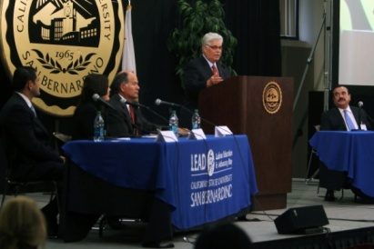

LEAD is a “Netroots Movement”
Netroots Advocacy – model of activism & democratic participation
LEAD is an umbrella and a “hammock” (hamaca) organization
Journal of Latinos and Education (JLE)
Handbook of Latinos and Education (HLE)
National Latino Education Network (NLEN)
Partnership-Building with Theme-Based Advocacy Groups
Social Networking, Listserv Information and Resource Distribution
across Affiliate Chapters
Host Public Forums, Virtual Classrooms, Video Production, & Internet/Web Streaming
Regional Alignment - Inland Empire Regional Collaborative
Policy Impact - Assembly Concurrent Resolution No. 137
College & Career Events, Workshops, & Fairs
- Cash for College, Scholarships, Awards, & Internships
- Feria Educativa / Educational Expo
Annual LEAD Summit – Showcase/Marquee Event

Slide 18
Discussion
What do Chicano/Latino students need now?
How can institutions be culturally affirming?
- What advocacy has worked for you?

Slide 19

Journal of Latinos and Education
The Journal of Latinos and Education (JLE) provides a cross-, multi-, and interdisciplinary forum for scholars and writers from diverse disciplines who share a common interest in the analysis, discussion, critique, and dissemination of educational issues that impact Latinos. There are four broad arenas which encompass most issues of relevance: (1) Policy, (2) Research, (3) Practice, and (4) Creative & Literary works.
JLE encourages novel ways of thinking about the ongoing and emerging questions around the unifying thread of Latinos and education. The journal supports dialogical exchange--for researchers, practitioners, authors, and other stakeholders who are working to advance understanding at all levels and aspects--be it theoretical, conceptual, empirical, clinical, historical, methodological, and/or other in scope.
JLE seeks to identify and stimulate more relevant research, practice, communication, and theory by providing a rich variety of information and fostering an outlet for sharing. The various manifestations of the diverse frameworks and topical areas typically range anywhere from--but aren't limited to--theoretical and empirical analyses, policy discussions, research reports, program recommendations, evaluation studies, finding and improving practical applications, carefully documenting the transition of theory into real-world practice, linking theory and research, new dissertation research, literature reviews, reflective discussions, cultural studies, and literary works.

Slide 20
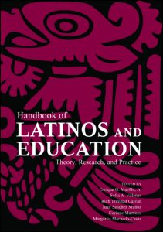
Handbook of Latinos and Education
Providing a comprehensive review of rigorous, innovative, and critical scholarship relevant to educational issues which impact Latinos, this Handbook captures the field at this point in time. Its unique purpose and function is to profile the scope and terrain of academic inquiry on Latinos and education. Presenting the most significant and potentially influential work in the field in terms of its contributions to research, to professional practice, and to the emergence of related interdisciplinary studies and theory, the volume is organized around five themes:
• history, theory, and methodology
• policies and politics
• language and culture
• teaching and learning
• resources and information.
The Handbook of Latinos and Education (HLE) is a must-have resource for educational researchers, graduate students, teacher educators, and the broad spectrum of individuals, groups, agencies, organizations and institutions sharing a common interest in and commitment to the educational issues that impact Latinos.

Slide 21

National Latino
Education Network
NLEN has been in existence since 2003.
Online Features and Benefits include:
An Archive/Directory that allows members to search and network with other registered members (individuals, institutions, businesses, agencies and groups).
A Resource Guide/Clearinghouse that allows members to search and browse for resources, opportunities and activities in the Latino Educational community.
An online and email Newsletter that allows members to access the latest information, news, stories and research on Latinos and Education.
E-Mail Listserve informing members of Breaking News that require immediate attention and action.
Programs and News broadcasted via video and audio broadband.
Latino Education & Advocacy Days (LEAD) Annual Summit and Events

Slide 22
LEAD Summit
The objectives of the LEAD summit are: 1) to promote a broad-based awareness of the crisis in Latino Education and; 2) to enhance the intellectual, cultural and personal development of our community's educators, administrators, leaders and students.
Our free one-day summit will:
Leadership: encourage leadership through our inspirational speakers. We ask ourselves: What are effective leadership strategies during these tumultuous times? As change agents, how do we think outside the box? What are effective innovations for closing the achievement gap, student retention and success; student services; teaching and academic affairs?
Diversity: provide education and resources in partnership with other educators to promote respect for differences and an appreciation of diversity. We ask ourselves: How can we best provide a challenging and supportive atmosphere for gender, racial and ethnic minorities?
Higher Education: encourage and provide opportunities for Latinos to attend college by sharing information regarding the California Law AB540, Financial Resources to help pay for college, and
information/recruitment to the plethora of advanced degrees offered by CSUSB, particularly the Ed.D. Doctorate Program in Educational Leadership.
Culture and Arts: celebrate our Latino heritage, spirit and achievement with displays of Latino art, music and history. This summit will provide a good opportunity to take a deeper look into the Latino family values that make Latinos a particular group by discussing our preferences, motivations, expectations and the impact of some of our cultural traits in educational endeavors as well as their linkages to the U.S. workplace and economy.
Resources: provide teaching resources and partners for teaching through our research, educational programs and the exhibits on display during the summit.

Slide 23
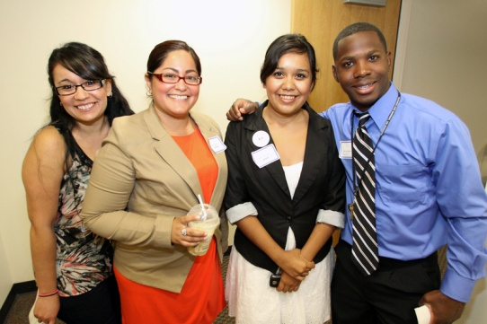
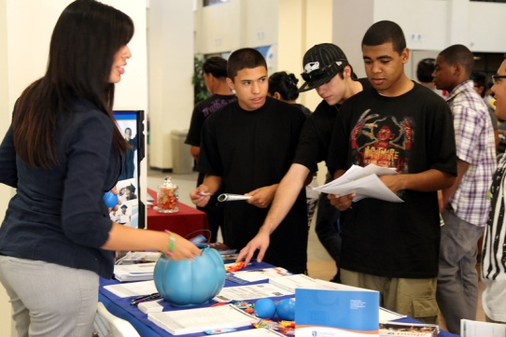
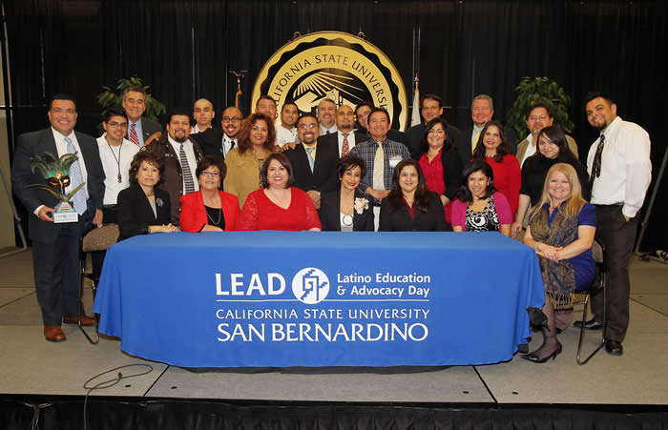
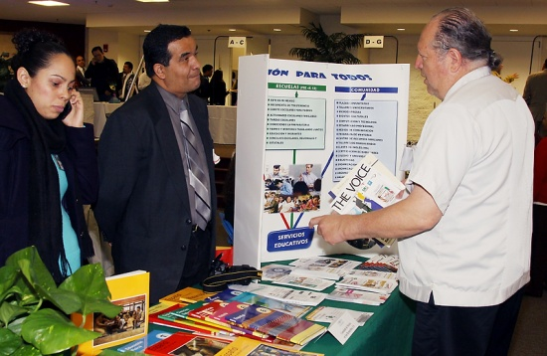
Volunteers
“LEAD is a volunteer-driven organization”
Volunteers
  Faculty, staff, students, and university administrators
  Recognition of Presidential Volunteer Service Award
  Community Involvement

Slide 24

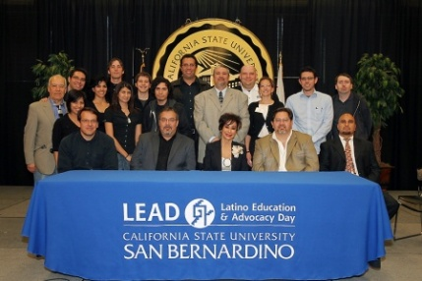

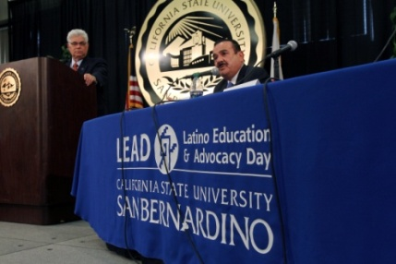
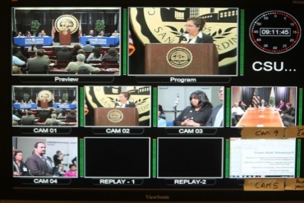
LEAD Technology
Website: http://lead.csusb.edu
  Working w/ Office of White House Initiatives
Webcast Partners: http://latinograduate.net
  In-Person Live Summit – multi-media (CSUSB ACM)
  Live Radio Broadcast: NBC Talk Radio
  Virtual Classroom – Online/In-Person Course Credit
  Cable Broadcast: Time Warner Cable Govt. Channel
Email Marketing & Event Registration
  Constant Contact - Eblast
Promote Town Hall Viewing Events
  University Network - List Serve, Word of Mouth
Social Media
  Facebook
  Linkedin
  Twitter
  YouTube

Slide 25
LEAD Impact Numbers
GRAND TOTAL = 18.25 million persons
1) Summit Attendees / - registrants and in-person participants on CSUSB campus, across the span of the whole day
= 1,100 unduplicated persons
2) Summit Webcast #1 / - persons viewing on-line (live and on-demand) via organized viewing events, across 1,300 campuses/institutions/sites, and across 18 countries
= 195,000 unduplicated persons
3) Summit Webcast #2 / - persons viewing on-line (live and on-demand) but not part of an organized viewing event
= 258,700 unduplicated persons
4) Summit Planning and Production / - organizers and managers, campus faculty, staff and students, volunteers, advisors, media and viewing partners, sponsors and donors, exhibitors, institutional contacts, and speakers and presenters
= 500 unduplicated persons
5) AM Radio / - multiple broadcast segments, teasers, and promotional PSAs
= 150,000 unduplicated persons
6) Internet Radio / - multiple broadcasts and podcasts, teasers, and promotional PSAs, across 7 countries
= 1,000,000 (1 million) unduplicated persons
7) Public Television / - multiple showings and multiple segments across national markets, reaching 100,000 households or 300,000 television viewers each
= 1,200, 000 (1.2 million) unduplicated persons
8) Commercial Television / - multiple broadcast and news segments, teasers, promotional PSAs, partial coverage of program
= 10,266,000 (10.27 million) unduplicated persons
9) Cable Television / - multiple interview segments and showings aired across broadcast outlets and markets, reaching 2,006,000 households
= 3,018,000 (3.02 million) unduplicated persons
10) Print Media / - multiple articles, archives, mentions, spots, highlights and ads in newspaper, magazine and journal outlets, postcards, and other literature
= 1,044,936 (1.04 million) unduplicated persons
11) Professional Networks and Scholarly Outlets / - multiple conference presentations and exhibits, professional meetings, consultantships, network members, publication subscriptions, purchases and downloads, project associates, editorial board members and advisors, reviewers, and published authors
= 102,475 unduplicated persons
12) Social Media and Networks / - multiple internet and web-based technologies, list serves, friends, likes, groups, views, members, visitors, and subscribers
= 1,500 unduplicated persons
13) LEAD-Affiliate / - meetings, presentations and expos, special and co-sponsored events and conferences, webcasts, forums, and web-event watch parties
= 4,000 unduplicated persons

Slide 26
LEAD Tasks, Themes & Items
1) Learn the traits, backgrounds, cultural histories, and diversity of- and among Latino groups.
2) Build teacher and counselor education programs which have an explicit student-home culture component so educators be not only sympathetic but appreciative and sensitive of students' backgrounds; and willing to structure the schooling experiences to be compatible with students.
3) Create qualified teachers that have specialized knowledge and skills in language acquisition, biliteracy, and cross-cultural learning. Build "grow your own" teacher recruitment and education programs, with candidates who have organic linkages to the communities in which they intend to serve.
4) Research the social reception received by Latino families and the impact of this on the learning of children.
5) Combat the deficit views of Latinos; incorporate students' language, culture, and experiential knowledge into schools; acknowldege that an educator's responsibility for providing students with particular academic content knowledge and learning skills should not conflict.
6) Create meaningful, trusting, horizontal and reciprocal relationships with Latino parents and extended family.
7) Short of a constitutional mandate for schooling at the Federal level, acknowledge that fundamentally, significant educational action is historically conducted at the level of States and our localities; thus, where much of our attentions should remain.
8) Draw together many diverse constituencies of vested interest and facilitate the growth or cluster of collaboratives or action zones that work together to meet educational targets for improvement. These include engagement among parents, students, and other concerned citizens into a movement of transnational proportions that will enable our voices to be heard in the public policy arena. These in turn foster creative learning and collaborative leadership projects among and within the action zones.
9) Maintain a basic ethos motivated by research, policy analysis and advocacy, education and community action. Foster the practice of research-based teaching and learning, and resist cooptation by political rhetoric, political parties, or unfunded governmental mandates.
10) Acknowledge that partnership-building is an action-based strategy, and that no responsible change comes without the public pressure that requires it.
11) Help empower Latino families with information and resources to succeed in the education system, thus fostering a strong culture in academic achievement and college aspiration.

Slide 27

CA Assembly Concurrent
Resolution No. 137
RESOLUTION CHAPTER 90
Assembly Concurrent Resolution No. 137—Relative to Latino Education and Advocacy Week. [Filed with Secretary of State August 17, 2010.]
LEGISLATIVE COUNSEL’S DIGEST
ACR 137, Carter. Latino Education and Advocacy Week.
This measure would declare the last week of March every year as a statewide week of advocacy for Latino education.
WHEREAS, The strength of the California education system and its place in a competitive global economy will depend largely on future educational outcomes among Latino students; and
WHEREAS, Latinos emerged as the largest minority group in the United States in the new millennium; and
WHEREAS, Statistically, since 1998, Latino children have become the largest minority student demographic in United States public schools; and
WHEREAS, Both Latino students and teachers have a high mobility rate, are located in racially segregated communities with high poverty rates, and attend schools with fewer resources, staffing, and programs; and
WHEREAS, Latino students have among the highest dropout rate, score among the lowest on achievement tests, and have low college enrollment rates; and
WHEREAS, One-half of all Latino students currently fail to graduate high school, and have had little progress in increasing college graduation rates over the last few decades; and
WHEREAS, Latino students represent an opportunity to increase diversity, strengthen the tax, labor, consumption, and investment pool, and increase ties with Mexico and Latin America; and
WHEREAS, Beginning March 29, 2010, California State University, San Bernardino, College of Education will host its inaugural Latino Education and Advocacy Week summit; now, therefore, be it
Resolved by the Assembly of the State of California, the Senate thereof concurring, That every year the last week of March is hereby declared as a statewide week of advocacy for Latino education; and be it further
Resolved, That the Chief Clerk of the Assembly transmit copies of this resolution to the author for appropriate distribution.

Slide 28



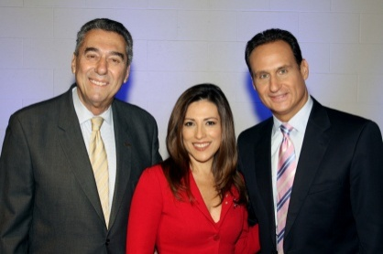

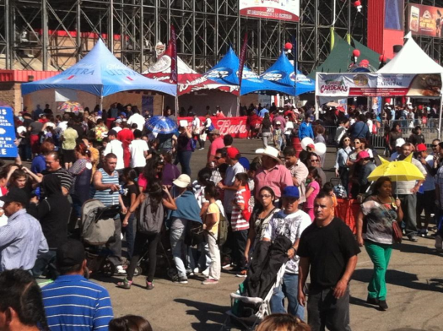
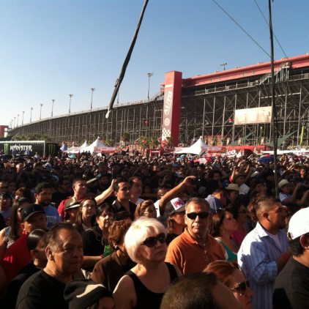

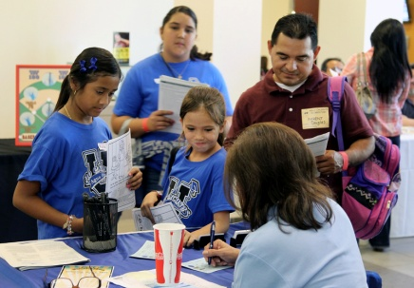
La Feria Educativa
College & Career Fair
Community Forums & Workshops (bilingual)
  Financial Aid Workshops/Cash for College
  Novelas Educativas
  Immigration: Dream Act & California AB-540
  College Access
  Life Preparation & Career Exploration in STEM
  Parental Engagement & Involvement
  Drop-Out Prevention & Enrichment Programs
Telemundo Television Taping & Broadcast
Educational Expo
  Carnival, Exhibits & Vendors

Slide 29
LEAD Inland Empire Regional Collaborative
The LEAD Education Projects will serve to coordinate and facilitate the development of a regional affiliate network.
Advantages & Opportunities of a “Committee of One”
Strategic alignment across the IE region
Relationship-building across affiliates
Leverage resources collectively, as a group
Pool our knowledge & expertise
Capacity-building across institutions, agencies, and groups
Brand enhancement of the network
Rank and prioritize the most pressing regional issues
Deliberate and decide on which of those issues we can agree to work on, and hone, collaboratively
Provide solutions specific and explicit to the IE (move away from the generic “one size fits all”)
Bring small successful models “up to scale”, therefore magnifying the positive effects
“Giving priorities” (the affiliate network acts as a broker and/or external evaluator, advising philanthropists, donors and funding agencies)

Slide 30


LEAD Inland Empire Regional Collaborative
The INLAND EMPIRE Regional Affiliate Network must demonstrate the following characteristics:

Slide 31

LEAD is the regional coordinating organization for Cash for College and in the last three years we have assisted more than 11,000 families in the Inland Empire to complete their FAFSA financial aid application. Our initiative brought in more than $56 million dollars to our region in what may had been otherwise unclaimed financial aid monies!
During January and February, students and families can attend FREE Cash for College workshops across the Inland Empire for help to fill out the Free Application for Federal Student Aid (FAFSA) and Cal Grant GPA Verification Form required for Cal Grants.
CASH IN ON A $1,000 SCHOLARSHIP!
High school seniors — attend a Cash for College workshop, complete an exit survey, apply for a Cal Grant by the March 2 deadline, and you could qualify for an extra $1,000 incentive scholarship! Students eligible for instate tuition assistance (AB 540) may also qualify for the incentive scholarship.

Slide 32
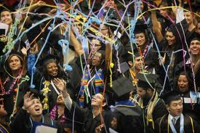

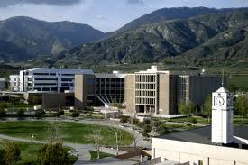


“What is the Impact of LEAD activities on community outreach and outcomes”.

Slide 33
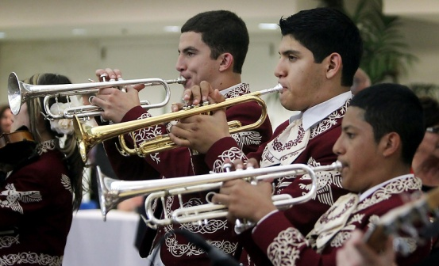
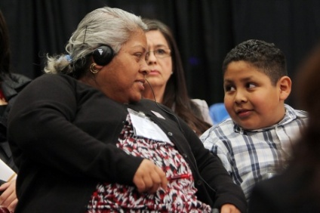







Community Outreach
School Districts in the region
  Teachers
  Students
  Parents (PTA’s)
  Administrators
  Board Members

Slide 34
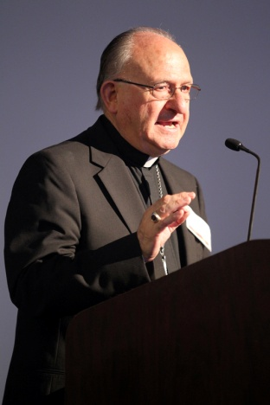

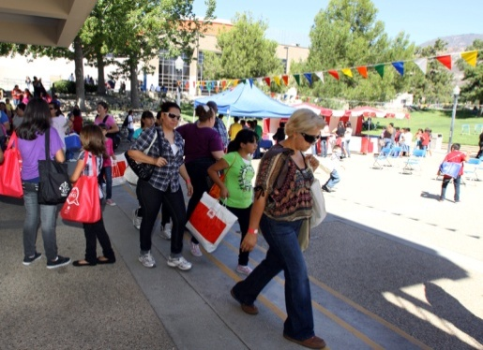





Community Outreach
Community Organizations
  Activist Organizations & Neighborhood Associations
  Foundations
  Churches

Slide 35
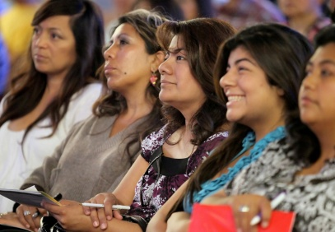
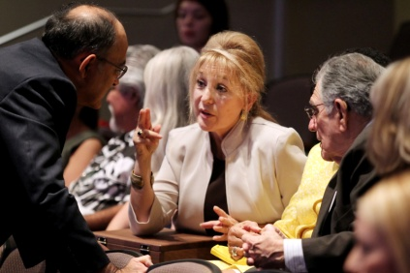
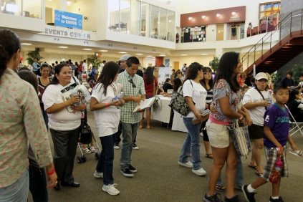
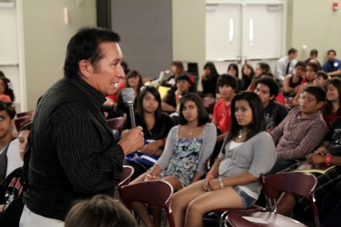
Outcomes
LEAD provided an effective forum for open discussion of educational issues affecting Latinos.
Created opportunities for development of viable solutions.
Created awareness of educational issues, solutions, and action plans.
Provided networking opportunities.
Helped to mobilized the community.

Slide 36

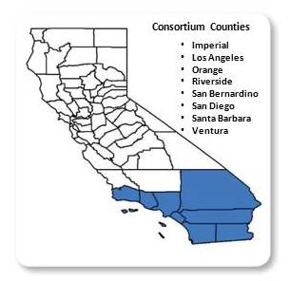
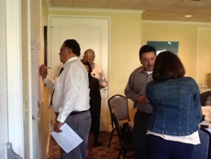
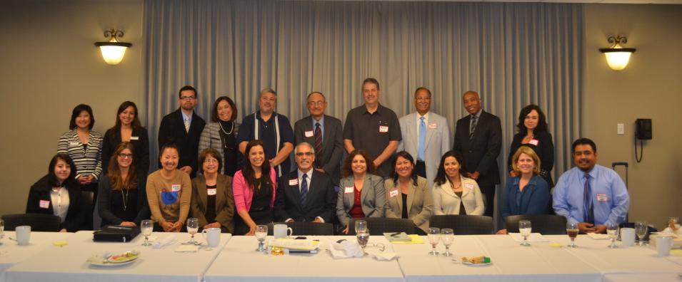
Southern California Consortium of Hispanic Serving Institutions (SCCHSI)
The Southern California Consortium of Hispanic Serving Institutions is committed to preparing Latino students for tomorrow’s challenges through collaboration and leveraging institutional strengths and resources. We will provide a cooperative vehicle to enhance the success of member institutions in reaching their individual and collective goals.

Slide 37


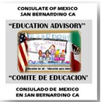
Instituto Binacional de Liderazgo para Padres / Binational Parent Leadership Institute
Purpose:
· Explore and establish an advanced binational organized Parent Involvement mechanism in the Inland Empire that will provide parents with institutional leadership trainings to become more effective change agents in service delivery for their families.
· Develop a process(s) for parents to create a cadre of leadership for direct input, parent voice, advocacy and impact in local/regional schools & communities and at state/national levels.
· Develop focus on effective strategies to meaningfully engage parents in planning, implementation and evaluation of services to ensure positive outcomes for families and students.
Consulate/SBCSS/LEAD (and/or also serving on the inuagural event's planning & curricula committee) are, thus far: - California Association for Bilingual Education (CABE), - Catholic Diocese of San Bernardino/Riverside Counties , - Consejo de Federaciones Mexicanas en Norteamérica (COFEM), - Mexican American Legal Defense and Educational Fund (MALDEF), - National Education Association (NEA) , - Parent Institute for Quality Education (PIQE), - Parents Teachers Association (CA State PTA), - Riverside County Office of Education (FIN), - Riverside County Office of Migrant Education Program, - SBCO Sheriff’s Department, - SBCSS (Family Involvment), - Secretaría de Educación Pública (SEP) de Baja California , - Training Occupational Development Educating Communities (TODEC)

Slide 38

THANK YOU – GRACIAS
Campus of California State University, San Bernardino
http://leadsummit.csusb.edu/

